Slide 1


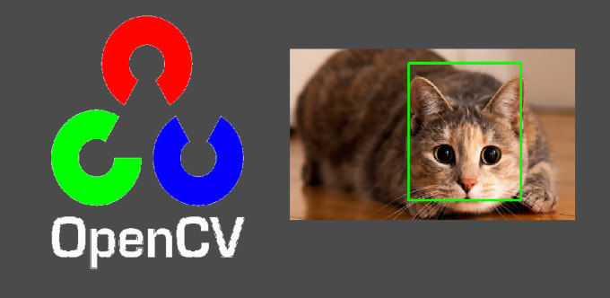
Session 3:
Loading and Displaying Images

Slide 2

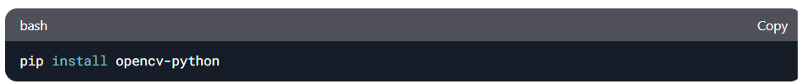
Open terminal install required libraries
Opening an Image
import cv2 # This is the OpenCV library!
# Open an image (like opening a treasure chest!)
image = cv2.imread("path/to/your_image.jpg") # Replace with your photos path!

Slide 3
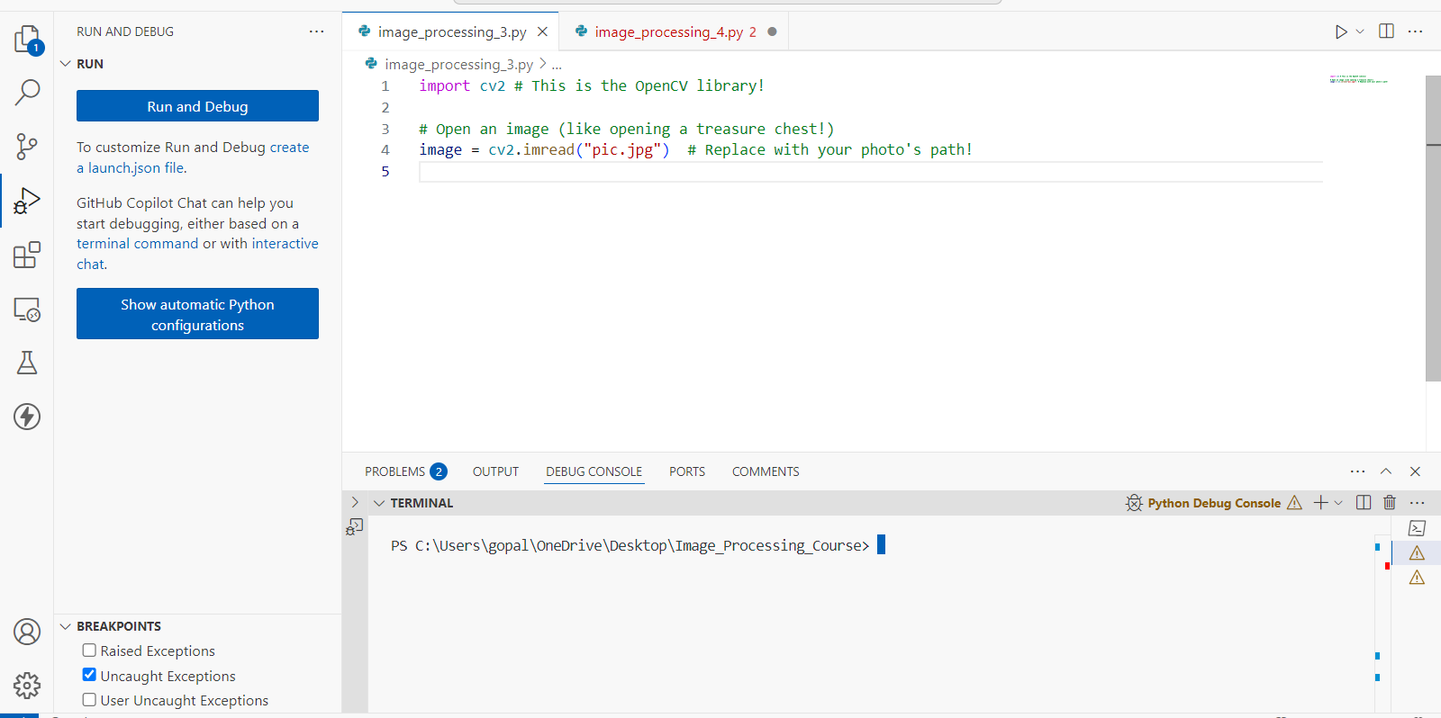

Slide 4
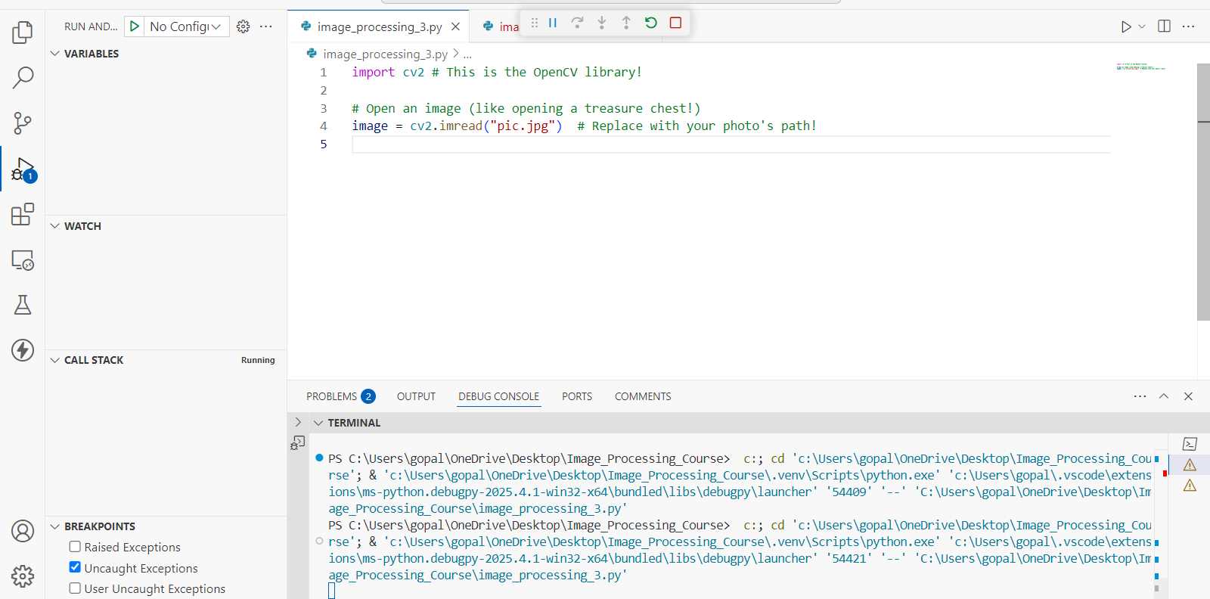

Slide 5
Explanation of the Code
1. Importing OpenCV
import cv2 # This is the OpenCV library!
cv2 is the OpenCV library, which is a powerful tool for image and video processing in Python.
By importing cv2, we gain access to OpenCV functions for reading, displaying, and processing images.
image = cv2.imread("path/to/your_image.jpg") # Replace with your photos path!
cv2.imread() is used to read an image from a specified file path.
The function returns the image as a NumPy array that stores pixel values.
How It Works Internally
When cv2.imread() reads an image, it loads it as a BGR (Blue-Green-Red) array by default.
Each pixel in the image is represented as an array of three values corresponding to the intensity of blue, green, and red.

Slide 6
Display the Image
import cv2 # This is the OpenCV library!
image = cv2.imread("pic.jpg") # Replace with your photo's path!
# Show the image in a window named "Window"
cv2.imshow("Window", image)
cv2.waitKey(0) # Wait for a key press
cv2.destroyAllWindows() # Close all windows when done!
Press any key on your keyboard to close the window.

Slide 7
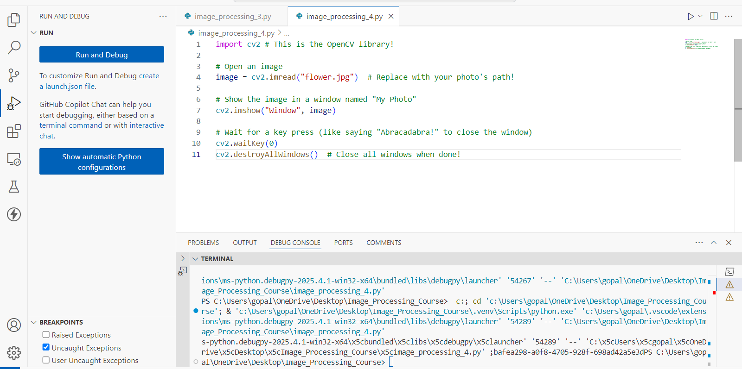
Display the Image

Slide 8
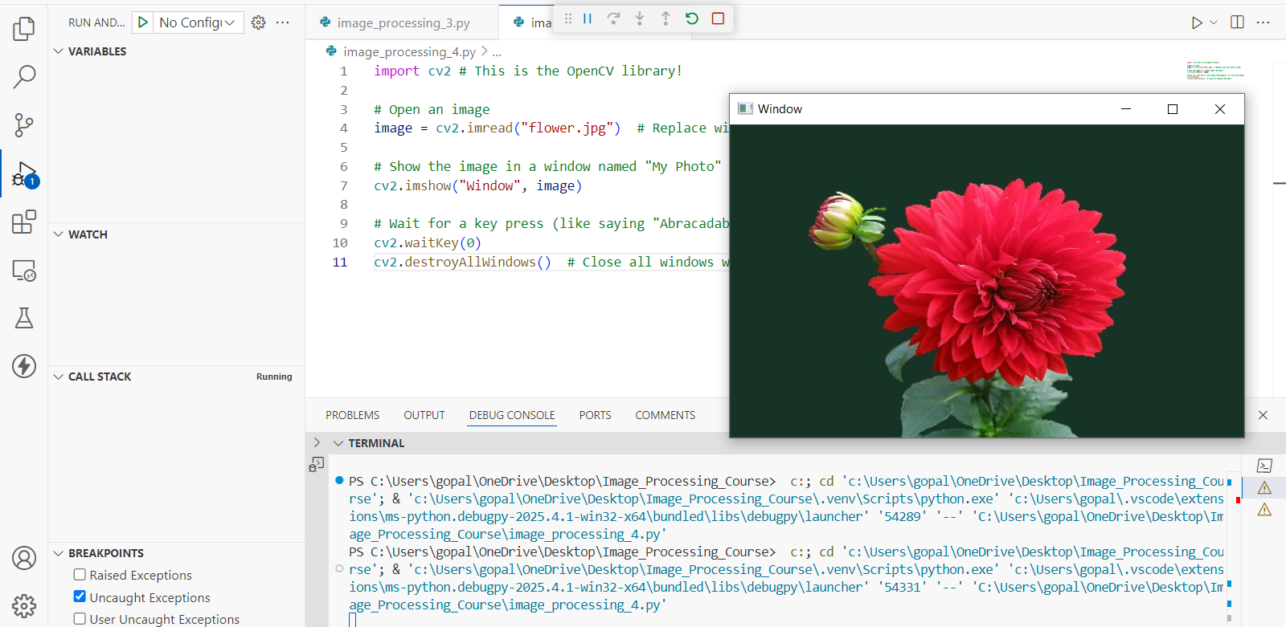

Slide 9
Explanation of the Code
1. Displaying the Image
cv2.imshow("Window", image) opens a window and displays the image.
"Window" is the title of the window (you can change this to any name you like).
image is the image array (loaded earlier using cv2.imread()).
The window will stay open, but it won’t respond to interactions until we add cv2.waitKey().
2. Waiting for a Key Press
cv2.waitKey(0) pauses the program indefinitely until a key is pressed.
If you replace 0 with a number (e.g., cv2.waitKey(5000)), the window will close automatically after 5000 milliseconds (5 seconds).
Without this function, the window might open and close instantly.

Slide 10
Explanation of the Code
3. Closing All Windows
cv2.destroyAllWindows() # Close all windows when done!
cv2.destroyAllWindows() closes all OpenCV windows.
If you want to close only a specific window, use:
cv2.destroyWindow(window_name) # Close a specific window

Slide 11
Save the Image
import cv2 # This is the OpenCV library!
image = cv2.imread("pic.jpg") # Replace with your photos path!
# Show the image in a window named "Window"
cv2.imshow("Window", image)
cv2.waitKey(0) # Wait for a key press
cv2.destroyAllWindows() # Close all windows when done!
# Save the image as a new file (like saving your artwork)
cv2.imwrite("C:\\SAMPLE_PATH\\Image_Processing_Course\\saved_imag.jpg", image)

Slide 12
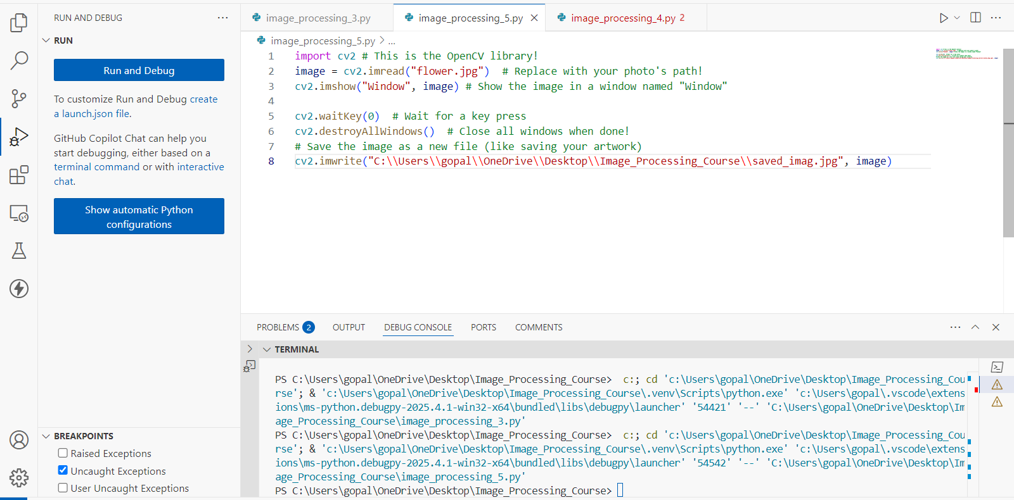

Slide 13
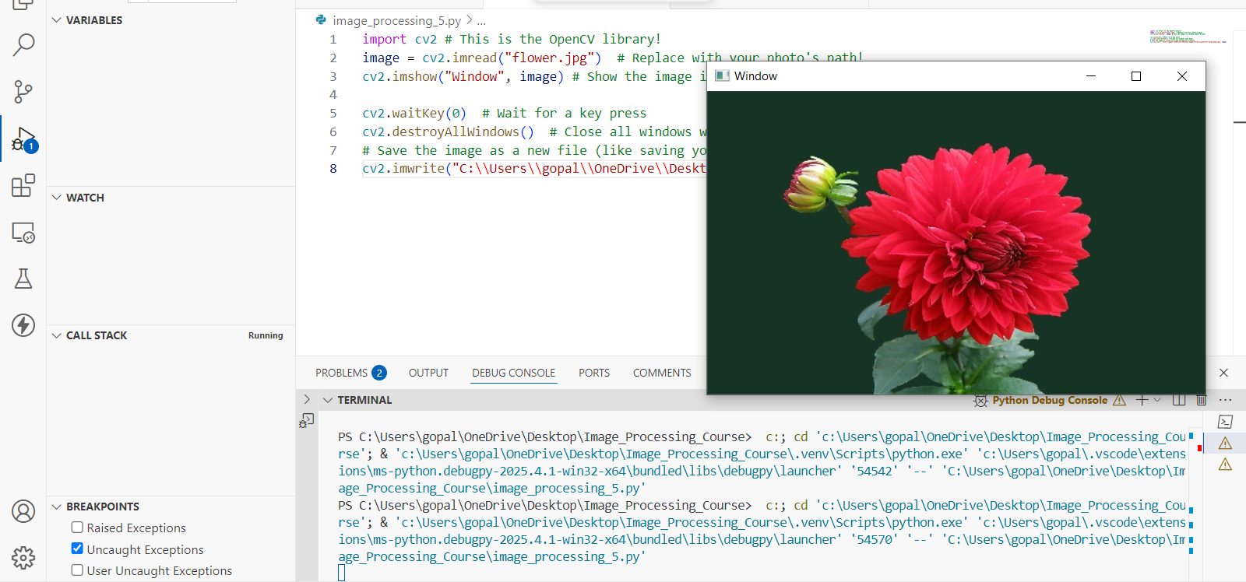

Slide 14
Explanation of the Code
File Format Support
OpenCV can save images in different formats (.jpg, .png, .bmp, .tiff, etc.).
Example: cv2.imwrite("saved_image.png", image) # Saves as PNG
Overwrite Warning
If a file with the same name exists, OpenCV will overwrite it without warning.
Saving Processed Images as well

Slide 15
Exercise
1. What is the function of cv2.imshow("Window", image) in OpenCV? A. It loads an image from disk B. It saves an image to a file C. It displays the image in a window titled "Window" D. It resizes the image
Answer: C. It displays the image in a window titled "Window"
2. How can you close a specific OpenCV window by its name? A. cv2.close("Window") B. cv2.removeWindow("Window") C. cv2.destroyWindow("Window") D. cv2.exitWindow("Window")
Answer: C. cv2.destroyWindow("Window")

Slide 16
Exercise
3. Which of the following file formats is not supported by OpenCV for saving images? A. .jpg B. .png C. .docx D. .tiff Answer: C. .docx
4. What does the cv2.imwrite() function return after execution? A. The image array B. The image path C. A boolean indicating success or failure D. The size of the saved image Answer: C. A boolean indicating success or failure

Slide 17
Exercise
5. What is a potential risk when saving images using cv2.imwrite() in OpenCV?
A. The image may open twice
B. The image might not display properly
C. It can overwrite existing files without warning
D. It always saves in grayscale
Answer: C. It can overwrite existing files without warning

